Slide 1
Expanding Your Business Room E
Low Income Investment Fund – Build Up Riverside County
June 1, 2024

Slide 2
Increasing the supply of child care
Workforce
Facilities

Slide 3
Increasing the supply of child care
Workforce
Facilities Development
Climate Resiliency
Facilities
Land Use
Funding

Slide 4
Increasing the supply of child care
Facilities
Facilities Development
Funding
Land Use
Climate Resiliency
FFN to Family Child Care Home to Child Care Center

Slide 5
Home-Based Providers

Slide 6
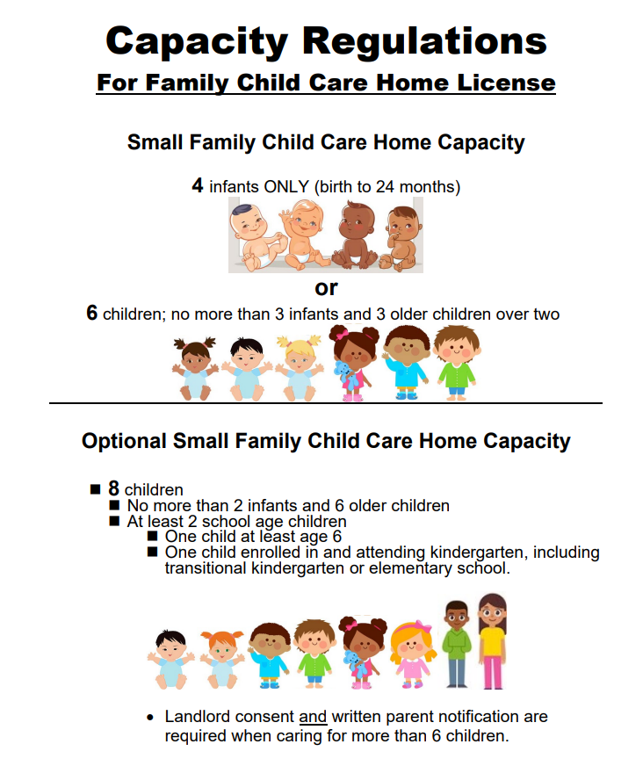
Steps to establishing a new home-based child care
Family, Friend, Neighbor
Attend Child Care Initiative Project (CCIP)
Small FCCH
Collect contact information of your local ECE agencies
Community Care Licensing Agency
Resource and Referral Agency
Local Planning Council Agency
First 5 Agency
Other Agency?
Attend Orientation for Licensing
Attend Child Care Initiative Project (CCIP)
Prepare to complete Licensing Application and Requirements. LIC 9217.pdf (ca.gov)
Child Proof you home
Consider budgeting for appropriate furniture, materials, and curriculum for the children
Complete application
Tb test, vaccines and Background checks completed on all adults
Notes:
The CCIP is a statewide project funded to build supply and improve the quality of care. Efforts include recruiting license exempt providers to become licensed, as well as providing supports to assist small homes with a goal of increased capacity and inclusion of infants and toddlers.

Slide 7
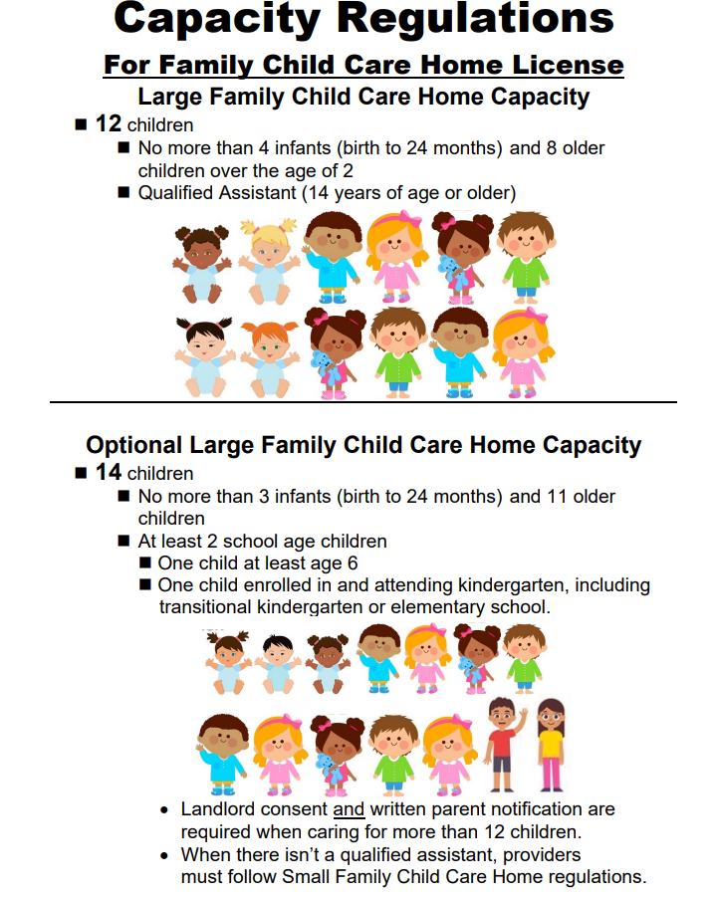
Moving from a small to large home-based license
Small to Large FCCH
Community Care Licensing Division
Have 1 year experience operating as a small family child care home licensee or show proof of 1 year experienced as a teacher/director of a licensed child care center.
Submit application to expand FCCH attached with Expansion Fee
Department of Building and Safety
Depending on the Jurisdiction, stalling fire alarm might require a permit and a licensed contractor to do the work
Fire Department
Fire Alarm system
Upgrade Fire Extinguisher
Tb Test and Background checks on additional staff
Consider budgeting for expanding on appropriate furniture and materials

Slide 8
SB234 – The Keeping Kids Close to Home Act
Do you know about SB 234 Keeping Kids Close to Home Act and why it is important to know if you are planning on expanding to Large FCCH?
Like Small FCC, Large FCCH are allowed By right
Fees are eliminated
CCLC Guides

Slide 9
In an ideal world, what resources should you have for this process?
Get Ready
Find your local Child Care Licensing office:
How to Become Licensed (ca.gov)
Find your local Child Care Resource and Referral Agency:
California Child Care Resource & Referral Network - Home (rrnetwork.org)
Are you ready to start a Family Child Care Home?
Why are you opening a Family Child Care Home business?
Are you ready to share your home with other children and their families?
Would this business best fit your family needs and is everyone at home on board to open a FCCH?
Would you consider to expand your FCCH from small to large in a year?
Are you Ready - Opening Home.pdf (childcareaware.org)

Slide 10
Do Your Research
Learn about your community needs
Family Child Care Needs Assessment:
Needs Assessment - Opening Home.pdf (childcareaware.org)
Licensing and Background Checks:
Licensing and Background Checks - Opening Home.pdf (childcareaware.org)
Legal, Tax, and Insurance Considerations:
Legal and insurance Considerations - Opening Home.pdf (childcareaware.org)
Take Action Steps
Attend Licensing orientation for Family child care:
https://www.cdss.ca.gov/inforesources/child-care-licensing/how-to-become-licensed/in-person-orientations
Complete licensing application
LIC279A, License Application and Instructions for Family Child Care Homes.
Complete 16 hours of Pediatric Health and Safety training
Get your vaccines up to date including TB test
Get your background done for all the adults in the home
Get ready for licensing inspection
Create a Budget
Develop Policies and Procedures
Market your Program

Slide 11
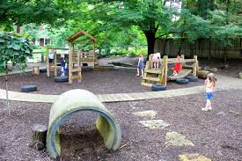
Training and Education
Professional Growth
Continue your education towards a Bachelor Degree
Education Stipend Program
California Child Care Permit
Resources:
Opening a Family Child Care Home Business Guide
Child Care Aware of America Opening a Child Care Program
Family Child Care Home Provider Requirements
Capacity Requirements FCCHs
Your local Planning Council
Your local First 5

Slide 12
Center-Based Programs

Slide 13
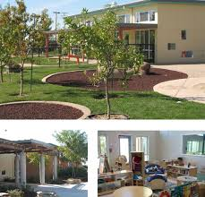
Steps to establishing a new center-based child care
Planning
Needs Assessment/Feasibility Study
Licensing Orientation, Legal and Insurance
Business Plan, Budget and funding/financing
Find a location
Regulatory processes and costs
Design, potential contractors and development team
Complete Business Plan, secure funding
Facility Development and Opening
Site construction and equipment
Develop Policies and Procedures
Licensing approval
Hiring Staff
Marketing

Slide 14
Center-based vs. Home-based: Title 22
Physical Environment
 | Centers | Homes
Indoor classroom space | 35 square feet per child; 1 toilet/2 sink per 15 | n/a
Outdoor space | 75 square feet per child | n/a
Center Staff MINIMUM Qualifications and Ratios
CCL Staff Qualifications | Director – 12 core Units, 3 Admin, 4 years teaching in center | Teacher – 12 core units, 6 months experience teaching in center
Preschool ratios | 1:12 | 1 teacher and aide: 15
Notes:
35/75 JUST for places where children can be
Staff Qual and Ratios are basic health/safety – State funded, quality requires higher levels
Changes with new single license
All sorts of other regulations for centers

Slide 15
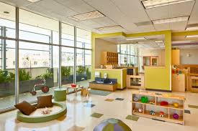
Center Licensing
Attend an orientation
Child Care Center Operators – California Child Care Licensing – Resources for Parents and Providers (childcarevideos.org)
Know CCL laws and regulations :Child Care
Child Care Aware of America – Center Resources
Complete application, handbooks, Live Scan
Submit application, pay fees :Reference Material for Applications - Child Care Program
Self-Assessment Guides and Key Indicator Tools
Pre-Licensing Visit
Receive License
Notes:
In Order to get a Child Care Center License: https://www.cdss.ca.gov/inforesources/child-care-licensing/how-to-become-licensed/ccc-licensing-information
Evaluator Manual chrome-https://www.cdss.ca.gov/Portals/9/CCLD/EM/Application-CCP.pdf - PG 19
Child Care Center Operators Videos https://ccld.childcarevideos.org/child-care-center-operators/
https://www.cdss.ca.gov/inforesources/letters-regulations/legislation-and-regulations/community-care-licensing-regulations/child-care

Slide 16
Who can provide additional support?
Experienced
Supportive
Connections
Knowledge and Resources
Notes:
Support Family Child Care provider through a very stressful process
Consultants usually have experience and connections with their local supporting agencies
Support with language barrier challenges

Slide 17
For Further Information or Questions Contact:
Andrea Del Valle
(951) 870 - 8112
adelvalle@liifund.org

