Slide 1
Summary Land Use Survey Data 2023
Thursday, August 10, 2023

Slide 2
Background
Build Up Riverside County would like to thank First Five Riverside County for funding this important initiative. This land use survey was created to gather information about the status of land use regulations and information gaps as it relates to operating child care facilities. Insights from the survey will help Build Up Riverside County to collaborate more effectively with the county and its cities by providing support and bridging communication gaps between child care providers and municipal governments in order to create a pathway for serving more children and their families.
Notes:
Build Up Riverside and First Five Riverside County
This land use survey was created with the intention to support the county and its cities in paving the road to make child care center and FFCHs more accessible to operate and build better communication channels between the child care sector and municipal government to expedite the adoption of SB 234
Responsibility to serve community BU Riverside County, LIIF, and First Five Riverside County Partnership are working together to make this

Slide 3
Cities response to Child Care Center and Family Child Care Home Definitions
Answered: 12 Skipped: 17
Answered: 14 Skipped: 15
Notes:
Question 1 and 2

Slide 4
100 % completion from all Riverside County jurisdictions
Answered: 29 Skipped: 0
City of Banning
City of Beaumont
City of Blythe
City of Calimesa
City of Canyon Lake
City of Cathedral
City of Coachella
City of Corona
City of Desert Hot Springs
City of Eastvale
City of Hemet
City of Indian Wells
City of Indio
City of Jurupa Valley
City of La Quinta
16. City of Lake Elsinore
17. City of Menifee
18. City of Moreno Valley
19. City of Murrieta
20. City of Norco
21. City of Palm Desert
22. City of Palm Springs
23. City of Perris
24. City of Rancho Mirage
25. City of Riverside
26. City of San Jacinto
27. City of Temecula
28. City of Wildomar
29. Unincorporated Riverside County Communities
Notes:
Question 4

Slide 5
CHILD CARE CENTERS

Slide 6
86% cities allow child care centers by right or with an administrative/non-discretionary permit
Answered: 29 Skipped: 0
Answered: 24 Skipped: 5
Notes:
Question 5 and 6
24 cities allowed child care centers by right or with an administrative/non-discretionary permit
For child care centers, Zoning districts administrative permit process apply
zones where operating a child care center is prohibited?

Slide 7
Most cities prohibit child care centers from operating in Industrial zones and Other*
“Other” responses were:
Commercial in Office Professional District or Service Industrial areas. Also sections of the Downtown Overlay are prohibited.
*For clarification of above - RC (Residential Conservation), Residential Agricultural, R-4 Multi-Family, Industrial, Airport Industrial
Business Flex (BF) District
Business Park, Commercial Neighborhood, and Mineral Resources
Child Care 9-14 Prohibited in Hillside Reserve Zone (Permitted only for Child Care up to 8 children); Child Care Center 16-30 Children Prohibited in Mixed Use & Resort Hotel Zone (Permitted for Child Care Centers up to 15 children) RMMC Section 17.10.012 & 17.08.012
Commercial, Regional (CR) and Special Purpose Zones (i.e., Open Space General/Recreation and Public/Institutional Zones)
Heavy Industrial (HI), all Open Space/Conservation zones, Public Utility Corridor (PUC) and Rail (RX) zones
Mineral Resources Areas, Watercourse, Watershed, Conservation Areas
Multi-family Residential
Only prohibited in Tourist Commercial, allowed as a Minor Use Permit in all other Commercial Zones
Recreation/Conservation & Public Facilities
Resource Recovery
Some residential zones. We do not have industrial zones.
Sports Complex Zone, Watercourse Zone, Open Space Zone, Natural Preserve Zone
Watercourse, Watershed, and Conservation Area
Answered: 29 Skipped: 0
Notes:
Question 7

Slide 8
Most cities require a conditional use permit in Residential zones and Other*
“Other” responses were:
A Minor Use Permit (MUP) is required, which is a simpler process than a CUP. A development permit may be required if the building is new, which has separate fees (~$9,250)
Agricultural (-Residential) zones, Specific Plan districts, Hillside (HS) zone
Commercial-Manufacturing Zone
Business Park
Business/Professional Office
Commercial if within 300 feet of residential
Commercial Neighborhood
Conditional Use Permit required for Child Care up to 15 children in Regional Interstate Commercial Zone; Conditional Use Permit Required for Child Care Center 16-30 Children in the Commercial Neighborhood, General Commercial, Community Commercial, Office, Light Industrial, & Regional Interstate Commercial Zones. (RMMC Section 17.10.012)
Day Care center allowed in some Downtown Areas with a CUP
Economic Development Corridor Zones & Commercial zones, except by right in the "Commercial Retail (CR)" Zone
Large family in residential and some commercial zones
Neighborhood Commercial, Service Commercial, Business Park Zones and Residential within the City's Development Code (Title 17 of the Temecula Municipal Code) require a CUP for ChildCare Center. NOTE: These may be outright permitted or conditional use depending on whether its a specific plan or if its not in a "Specific Plan" area of the City but we will use the City's Development Code (Title 17 of Municipal Code)
NO CUP required
Public Facility Zone
R-3, Mixed Use, and C-1 Zones
There is no CUP applicable for child care centers / Plot plan
Answered: 29 Skipped: 0
Notes:
Question 8

Slide 9
Average length of time to complete the review process for a child care center permit
Answered: 29 Skipped: 0
Notes:
Question 10
60% takes more that 6 weeks, More than half

Slide 10
What triggers the holding of a public hearing in order to obtain a child care center permit?
Answered: 29 Skipped: 0
Notes:
Question 13

Slide 11
27 cities have costs associated with the appeal process
Answered: 29 Skipped: 0
Notes:
Question 18

Slide 12
Most child care centers are required to pay a business license fee
Answered: 28 Skipped: 1
Sample fee responses from select cities:
“Starts at $151 - child care services varies on the gross receipts received or expected to receive in 12 months of business.”
“Non-profit no fee. For profit is based off of the annual gross receipts”
“Dependent on size min. $67”
“cost based on gross income”
“$60-$600 based on gross receipts of business”
“$15/child 1-6, additional $2 for each child”
Notes:
Question 20

Slide 13
FAMILY CHILD CARE HOME

Slide 14
72% of the respondents’ jurisdictions indicated that Family Child Care are disallowed by right
Answered: 29 Skipped: 0
Notes:
Q24: Are there any zones where a family child care is not allowed by right?
We can hide this since the next question is more detailed and answers the same. Or prelude the next by saying "70% of the respondents' jurisdictions indicated that FCCs are disallowed by right"

Slide 15
Over 83 % of cities allow family child care homes by right in Residential Zones
Other comments:
Agriculture, Commercial, Industrial, Mixed-use
Business Flex (BF) District (due to ALUC)
Business/Professional Office; public/semi-public facility
certain commercial zones
Commercial Neighborhood
Downtown District
Family child care is by right in all residential zones; however, a Large Family Day Care permit is required for Large Family Day Care
Large facilities are not allowed in some residential (RM, RH, RVH zones) or Mixed Use Zones. Fam. child care not allowed in some commercial/office zones (CN/OP zones) or Special Use Zones (OSG, OSR, PI).
Resource Recovery
Some residential zones. We have no industrial zones.
Zones in which residential dwellings are not allowed as a use: Commercial, Industrial, Manufacturing, Mineral Resources Areas, Watercourse, Watershed, Conservation Areas
Notes:
Question 25
Zones where family child care are not allowed by right:
Menifee charge for permit
Canyon lake, said some residential zones
Indian Wells said residential zone
Riverside County said some residential zone
San Jacinto said some residential zones

Slide 16
More than half of cities require family child care homes to pay a business license fee
Answered: 29 Skipped: 0
Notes:
Question 26
Family child care required to pay a business license fee

Slide 17
Over 50% of the jurisdiction require large family child care homes to obtain a permit for fire department clearance
Answered: 29 Skipped: 0
Only 6 cities do not require large family child care home providers to obtain a permit for fire department clearance, which will allow the provider to get license sooner and save them money.
Notes:
Question 28

Slide 18
Riverside County – State Law SB 234 Overall Results

Slide 19
More than 80% of cities in Riverside County are aware of state law SB 234 requirements
Answered: 28 Skipped: 1
Answered: 29 Skipped: 0
Answered: 9 Skipped: 20
Notes:
Aware of state law SB 234 requirements which exempt small and large family child care home from any licenses, permits, home occupation permits, or fees (Gov. Newsom Signs SB 234, the "Keeping Kids Close to Home Act" | Senator Nancy Skinner (ca.gov))?
When do you expect to change code to comply with state law requirement Gov. Newsom Signs SB 234, the "Keeping Kids Close to Home Act" | Senator Nancy Skinner (ca.gov)?

Slide 20
GENERAL PLAN

Slide 21
Only five cities will update their general plan within 12 months
Answered: 29 Skipped: 0
When is the next update to your city’s general plan?

Slide 22
Less than half of cities are certain that child care is included in their current general plan
Answered: 29 Skipped: 0

Slide 23
63% of the respondents’ jurisdictions indicated there is a primary point of contact in your planning department.
Answered: 29 Skipped: 0
Notes:
Q34: Is there a primary point of contact in your planning department for child care providers to reach out to with questions?

Slide 24
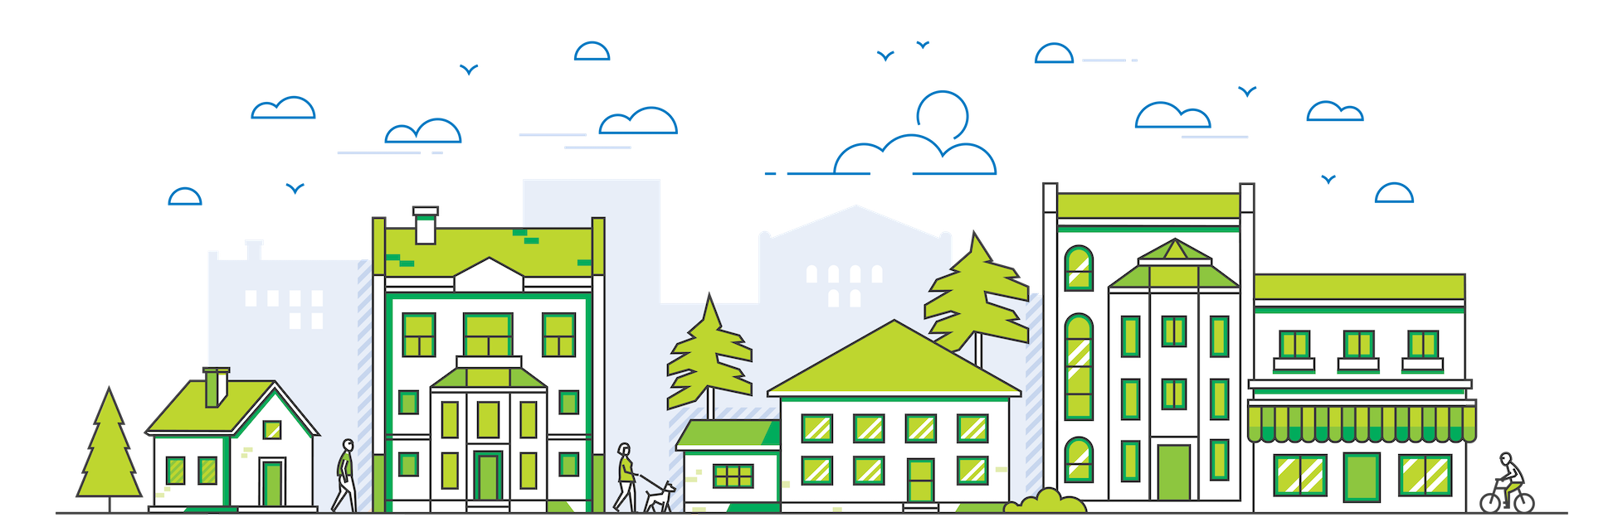
For Further Information or Questions Contact:
Andrea Del Valle
adelvalle@liifund.org
951.870.8112

